Slide 1
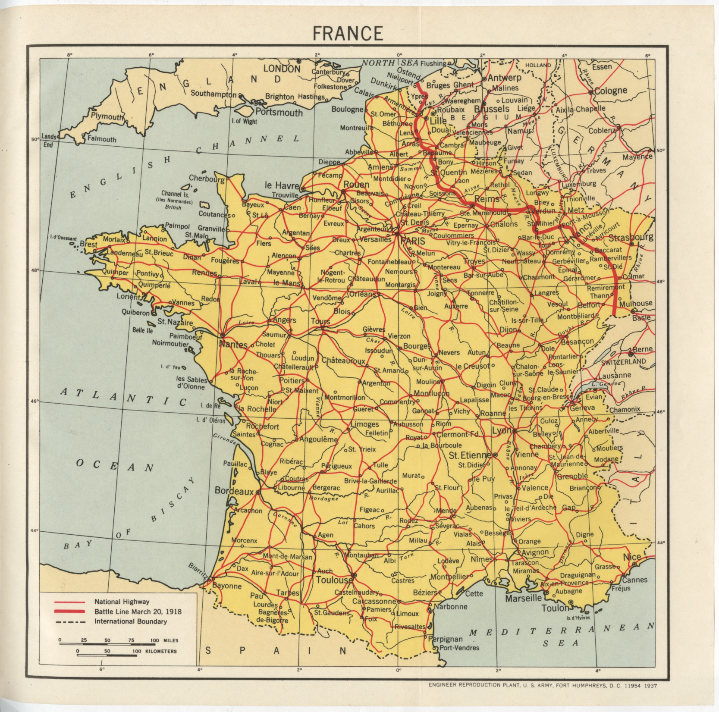
Notes:
Point out the bold red line to students. What is this line showing, according to the key? (The battle front as of March 1918).
Why is this area of France of key significance? (near German and Belgian borders, close to Paris, area historically contested between the two nations, rich farmland)

Slide 2

Notes:
“Zoom in.” What do you notice now about this area? (Many rivers, Meuse, Aisne, Morelle, Somme).
Point out that Metz is the end of a RR line. Why would that be important in wartime? (access to materials/supplies, moving troops). Remind students that American troops begin fighting in the summer of 1918, in that region.

Slide 3
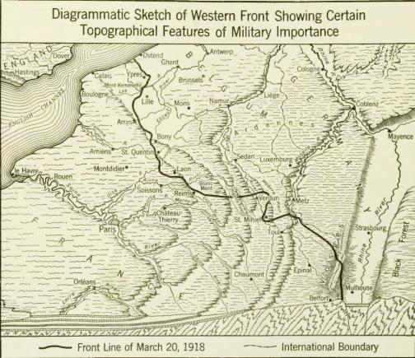
Notes:
What features would be of military importance? Notice the forests!

Slide 4
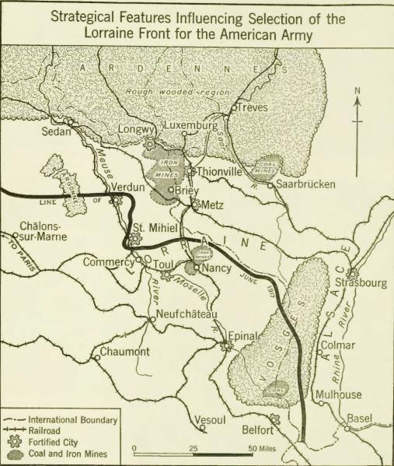
Notes:
See the iron mines and coal mines. The RRs are clearly marked on this map.

